Slide 1
Web-editor for reproducible pipelines
Daniil Fedorov, Sergeev Ilya, Shtanov Andrey, Daragan Daniil

Slide 2
MLDev experiments web application
A web application and a visual studio code extension for editing pipelines with auto-saving and automatic syntax and cohesion checking, embedded into the “MLOps Platform”.
MLDev experiments configurations CRUD.
Online editor with syntax highlighting, formatting.
Real Time collaboration with built-in git support system.
Experiments visualizer.
Team: Daniil Fedorov, Sergeev Ilya, Shtanov Andrey, Daragan Daniil
Project repo: https://github.com/dr0p-table-users/asd
This report: https://docs.google.com/presentation/d/1nZmJWSpytLEOG-2TrB37oQ8E7vVs-HiyGGWIwNoLjpE/edit#slide=id.gebdfeb45a5_0_0

Slide 3



Personas
Danil Danilich <Data Analytic>
A blue T-shirt man who works as a Data Analyst. He is using MLDev experiment pipelines, but tired from lack of syntax highlighting, auto-completion and visualization.
Wiki page: https://en.wikipedia.org/wiki/Data_analysis
Andrey Andreyich <ML Ops Engineer>
A red T-shirt man who works as a MLOps Engineer with 100 clones of Daniil Daniilich. He is tired that all data analysts in his company run MLDev pipelines in their inconsistent environments leading to lots of errors.
Wiki page: https://en.wikipedia.org/wiki/MLOps
Notes:
Даня

Slide 4
Value proposition canvas. Danil Danilich <Data Analyst>
Gain creators
Gains
Web UI instead of CLI. Plugin for experiment.yaml for vscode
Wants to use preconfigured automated data pipelines for everyday work without writing bash scripts
Jobs To Be Done
Pain Relievers
Products & Services
Wants to use an automated data pipelines from MLDev via web interface
Use YAML text editor. Use Jenkins with bash scripts.
MLDev experiments web application. Jenkins. Bash. Python
Pains
No mldev yaml syntax highlighting, autocompletion. No UI visualization of pipelines
Notes:
Даня

Slide 5
Value proposition canvas. Andrey Andreyich <ML Ops Engineer>
Gain creators
Gains
Web UI available for anyone with a browser
Wants to configure 1 environment instead of 100 ones
Jobs To Be Done
Pain Relievers
Products & Services
Wants to use a web interface with MLDev infrastructure
Use RDP.. Use Jenkins. Use bash/python scripts.
MLDev experiments web application. Jenkins. Bash. Python
Pains
Data Analytics get lots of errors due to their environments. Deployment is not possible
Notes:
Даня

Slide 6
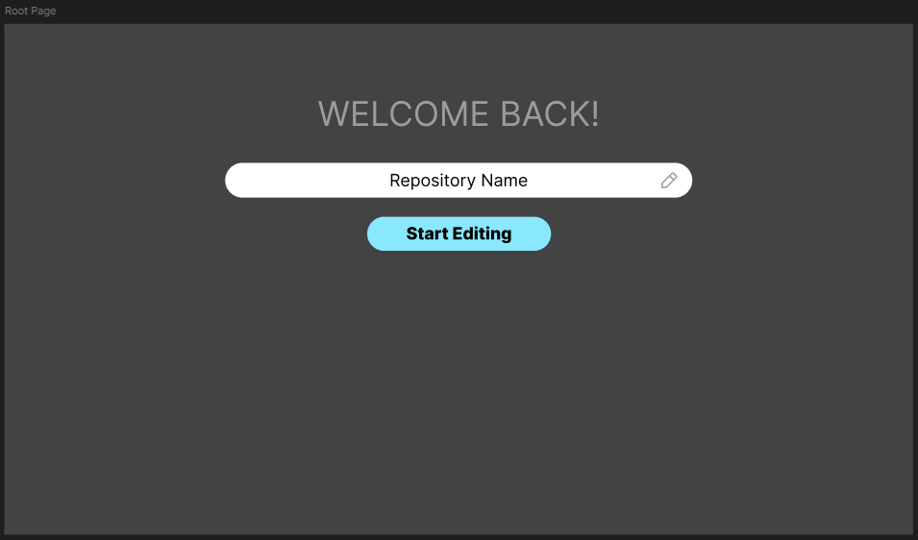
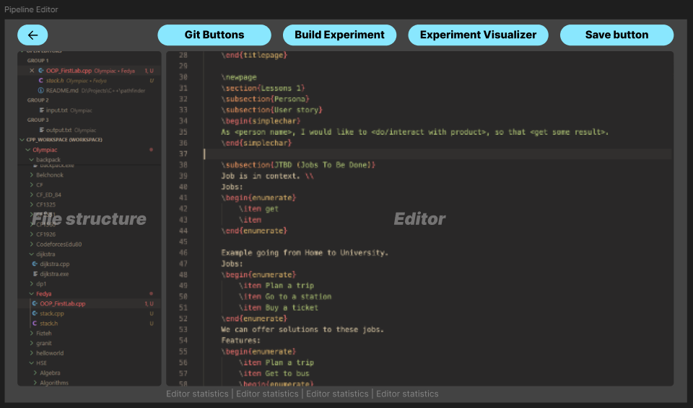
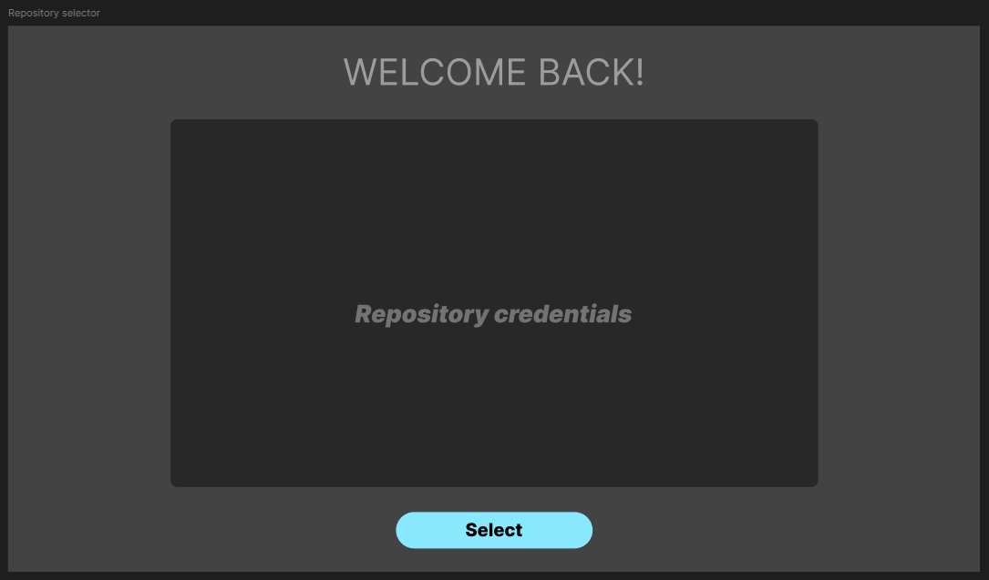
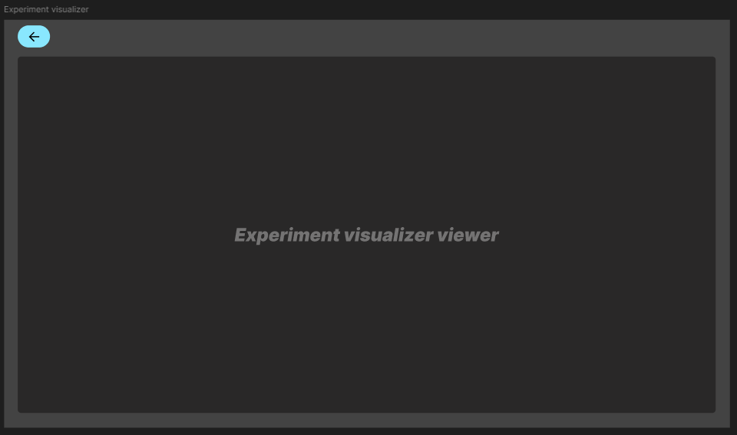
PROTOTYPE USER INTERFACES (WIREFRAMES)
Root page
Pipeline editor
Repository Selector
Experiment Visualizer
https://www.figma.com/design/1fi6rkeEC7icfPnvFAQpEE/ASD?node-id=0-1&t=zpN2xAhtU3kZGSI4-1

Slide 7
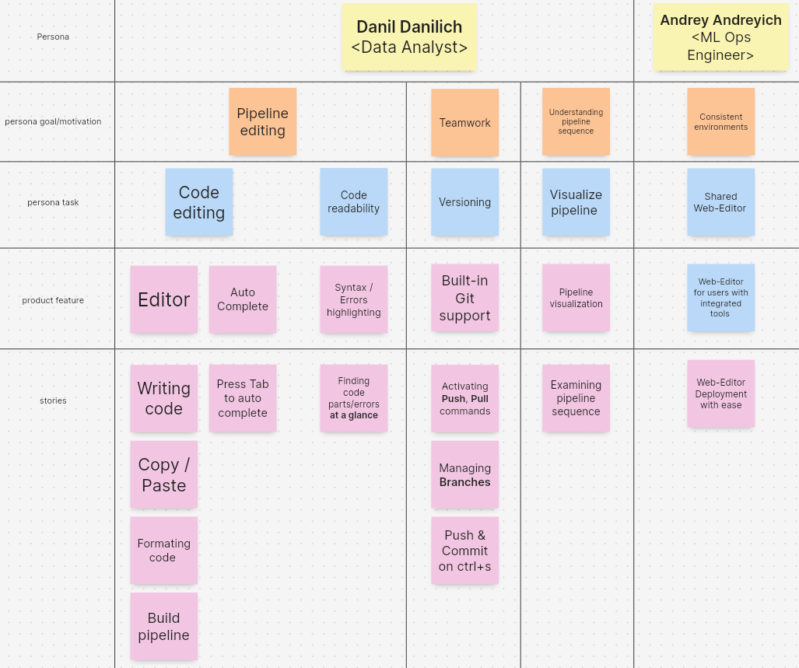
STORY MAP
https://app.holst.so/share/b/fc46cf03-4f34-4eee-96be-1032391d0cd0

Slide 8
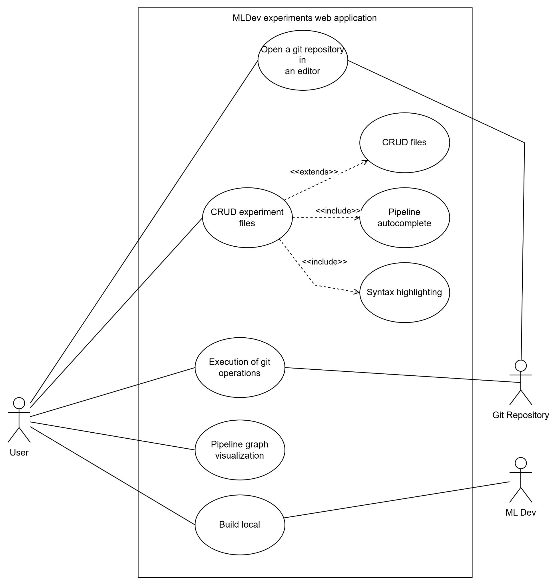
Use case diagram

Slide 9
Interaction analysis
Web-Editor
Responsibility | Colleague (other class)
Store pipeline (Know) | Pipeline Repository
Create pipeline (Do) | Pipeline Repository, Authorization system
View pipeline (Interact) | Pipeline Repository, Authorization system
Edit pipeline (Do) | Pipeline Repository, Authorization system
Check Code (Interact) | Syntax Analyzer
Visualize Experiment (Do) | Pipeline Repository, Visualizer
Call CI/CD Ops (Interact) | Pipeline Repository, MLDev Builder

Slide 10
Interaction analysis
Pipeline Repository
Responsibility | Colleague (other class)
Get Experiment data (Know) | Web-Editor
Perform git operations (Do) | Web-Editor

Slide 11
Interaction analysis
Syntax analyzer
Responsibility | Colleague (other class)
Verify syntax (Know) | User Pipeline Repository
Provide syntax errors info (Interact) | Web-editor

Slide 12
Interaction analysis
Visualizer
Responsibility | Colleague (other class)
Get experiment contents (Interact) | Web-editor, Pipeline Repository
Display experiment as a graph (Do) | Web-editor

Slide 13
Interaction analysis
MLDev Builder
Responsibility | Colleague (other class)
Build (Do) | Pipeline Repository

Slide 14
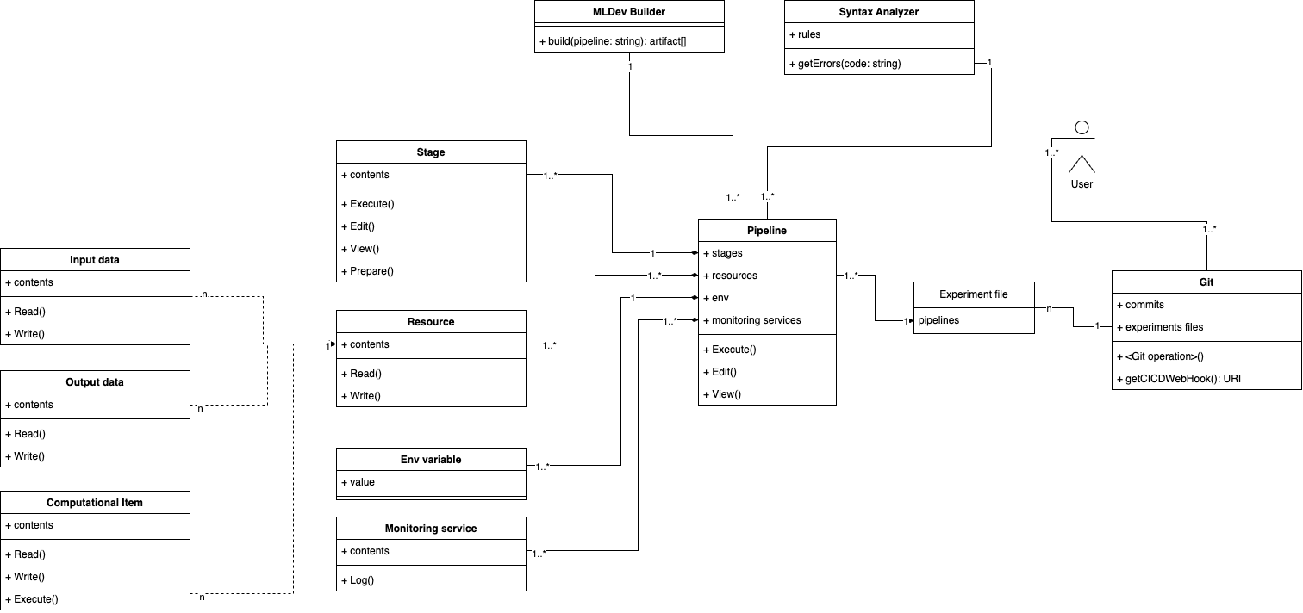
Updated class diagram
Notes:
Basically, the heart of the project are files. Especially, experiment files like pipelines. They have their own structure which can be analyzed

Slide 15
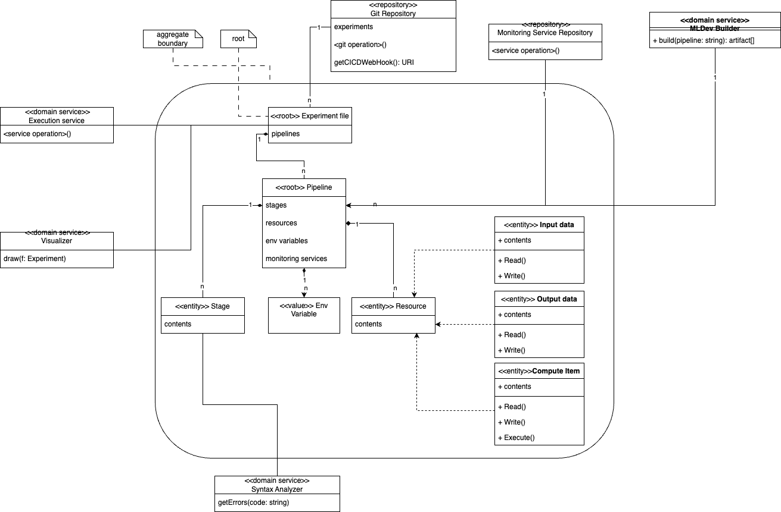
Updated domain diagram

Slide 16
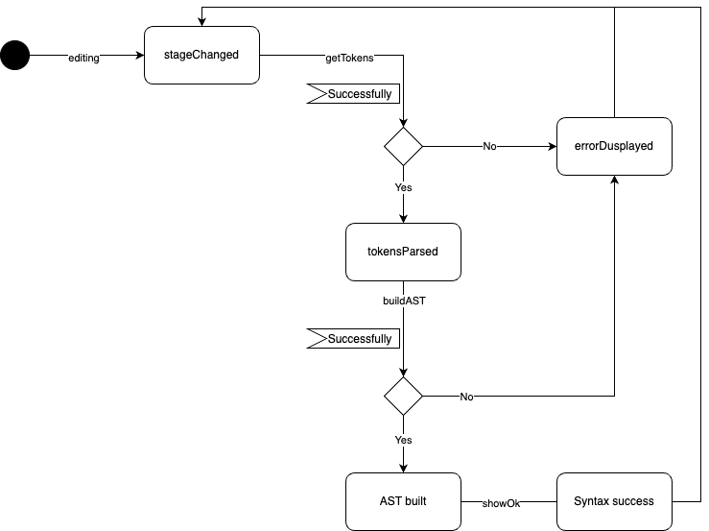
Detailed behavior: syntax analysis

Slide 17
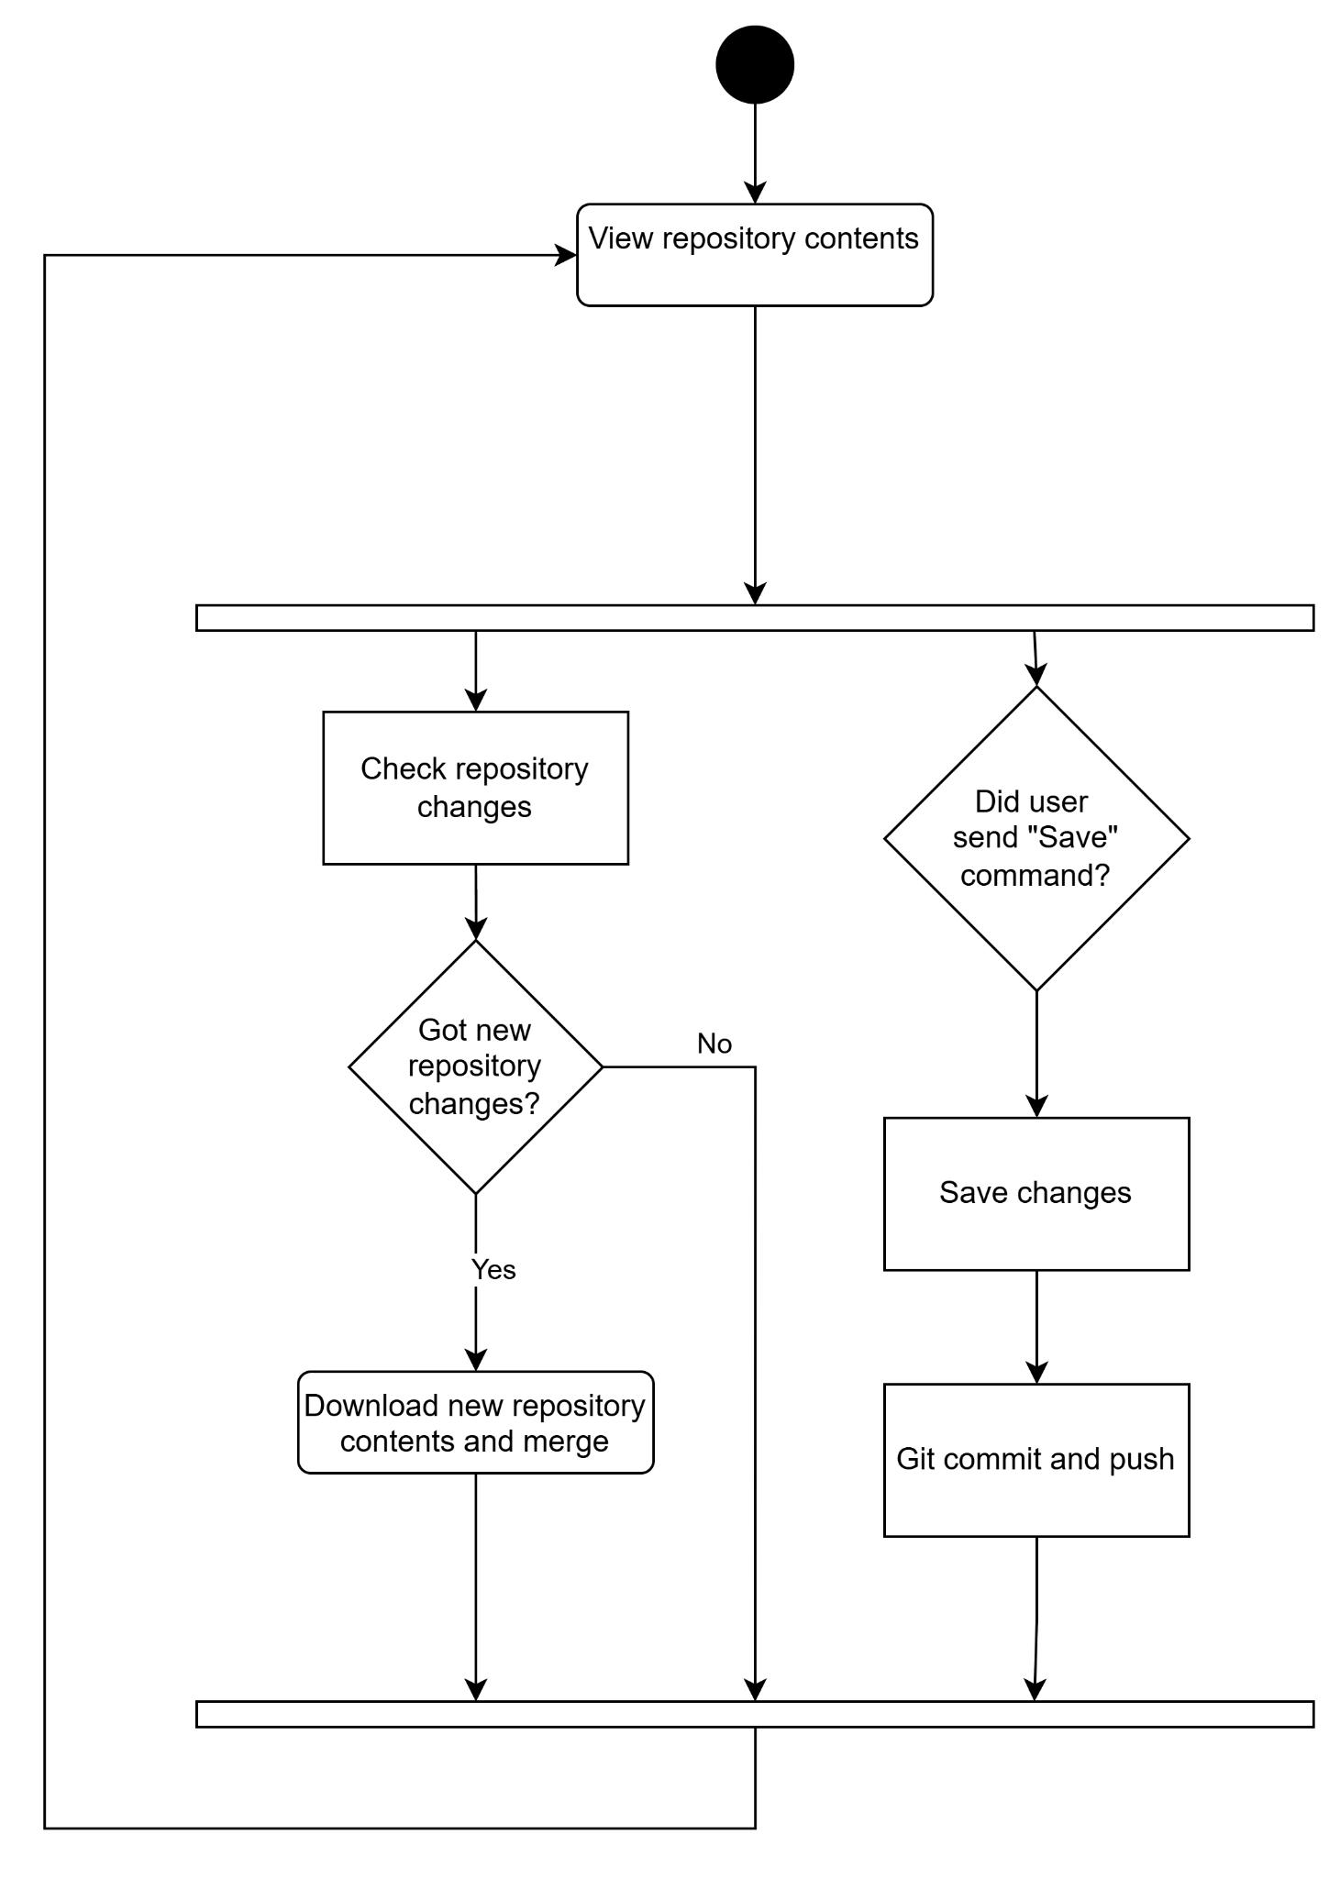
Detailed behavior: collaboration

Slide 18
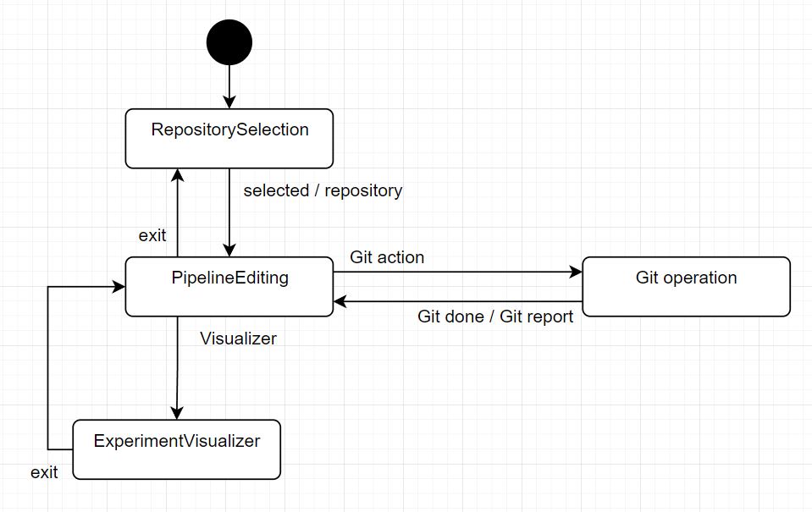
Detailed behavior: experiments CRUD

Slide 19
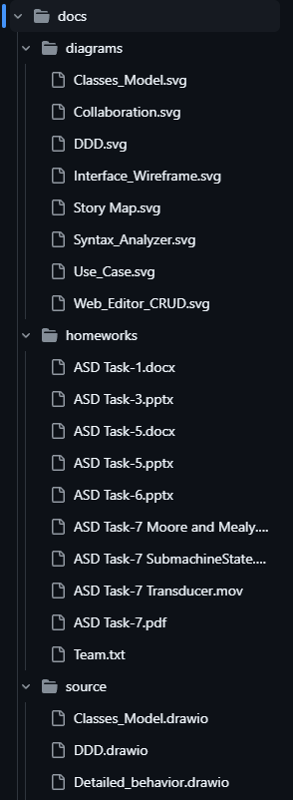
Repository structure
Our repository
root
src
Source files
docs
Documents
diagrams
Compiled diagrams
source
Source code for diagrams (draw.io)
homeworks
Homeworks (videos, presentations)
https://github.com/dr0p-table-users/asd/tree/dev

Slide 20




Team and roles
Sergeev Ilya
Fedorov Daniil
Shtanov Andrew
Architect (probably), full-stack developer
Architect, system analyst (in the MLDev chat)
Architect, ui developer, “Avatar” fan
Tg: @IlyaLayk
Tg: @nullone01
Tg: @Dark_AndrewFOX

Slide 21
Responsibility table
 | Description | Value proposition | Story Map | UI Prototype | Use Case | Class diagram | DDD diagram | Detailed behaviour
Sergeev Ilya | X | X |  |  | X | X | X | X
Fedorov Daniil |  | X | X |  | X | X | X | X
Shtanov Andrew |  |  | X | X | X | X | X | X

Slide 22
Thank you for your attention !

